Slide 1
GAR
Session 07: The Legend of Zelda
Notes:
Welcome. Today we build The Legend of Zelda. The main topic: events.
Start by playing the finished game, Zelda7, before any code.

Slide 2
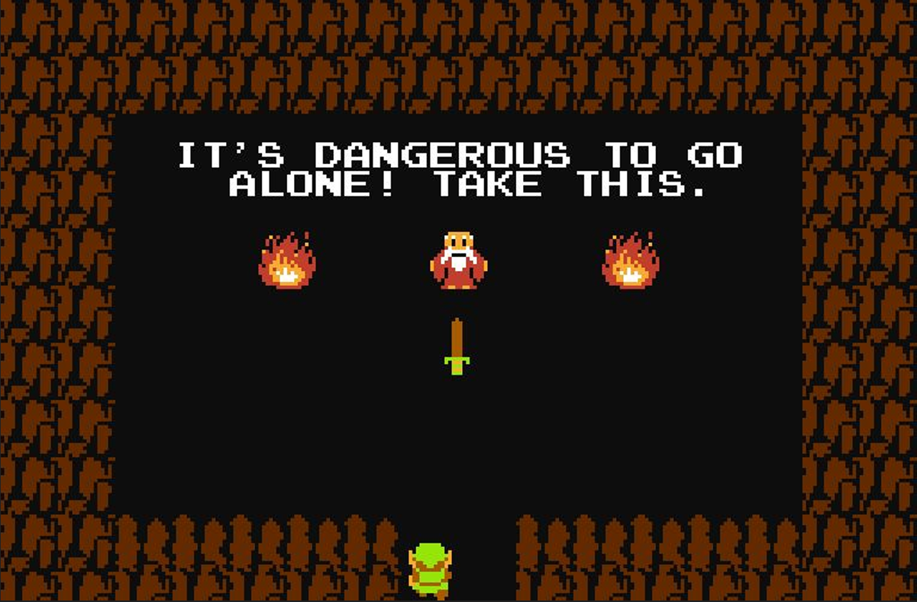
The Legend of Zelda
The Legend of Zelda (Nintendo, 1986). Screenshot © Nintendo.
Notes:
The 1986 original: top-down, room by room. Ask who has played a Zelda.

Slide 3
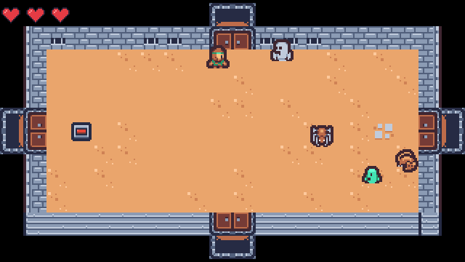
Today’s Goal
Notes:
Run Zelda7 and play it for a minute.
Ask: what would you need to build this? Collect answers on the board, and come back to them at the end.

Slide 4
Today’s Topics
Main topic: Events
Dungeon Generation
Hitboxes/Hurtboxes
Observer Pattern (Delegates & Events)
A Tweening System
Data-Driven Design (again)
Composition vs. Inheritance
Notes:
Today’s main topic is events. We look at the Observer pattern and how C# does it with delegates, events and lambdas. Also hitboxes, a tweening system, and composition vs. inheritance, which Plants vs. Zombies picks up.

Slide 5
Source Code
github.com/Metamate/gar-games, folder 07-the-legend-of-zelda
Its README: the steps (Zelda0 to Zelda7), where things are in the code, how to run it
The course site: today’s concepts in full, the exercises, and questions to check yourself
Notes:
Open gar-games/07-the-legend-of-zelda live. Show the README: the step table, the code map, how to run a step.
Say: the site explains the ideas, the README helps you find them in the code, the slides are for today.

Slide 6
Steps
Zelda0: rooms generated as tilemaps
Zelda1: the player, top-down movement
Zelda2: enemies and AI
Zelda3: combat (hitboxes, hurtboxes and damage)
Zelda4: events (player death, the floor switch and doorways)
Zelda5: screen scrolling between rooms
Zelda6: stenciling the door arches
Zelda7: audio (the finished game)
Notes:
The eight steps, one idea each. The README has the same table with more detail.

Slide 7
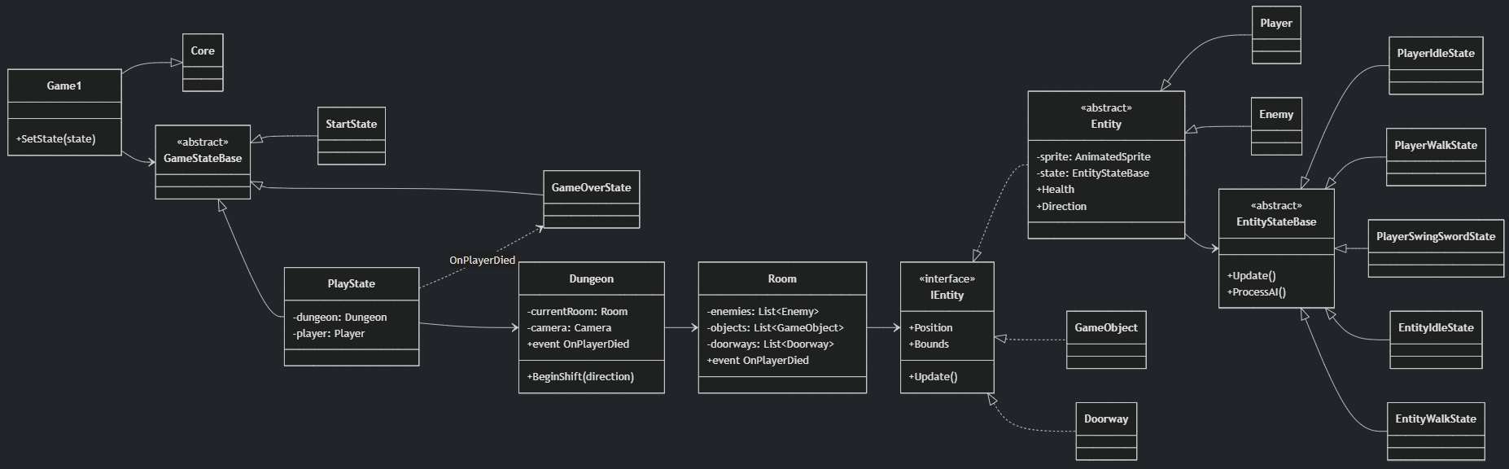
Diagram
Notes:
The finished game’s main classes. Don’t read it all: find Entity, Player, Enemy, Room and Dungeon.

Slide 8
Explore the Codebase
Take ~15 minutes to browse the finished game, Zelda7. Use the README as a guide if you need it.
Find where the game transitions between the title screen, gameplay, and game over
How does the player move?
Find where a new room is generated and what it contains when it is created
The player and enemies share a lot of code
  Find the common base and explain what it provides
Trace what happens from the moment the player presses the spacebar to an enemy taking damage
Notes:
Fifteen minutes in pairs with Zelda7 and the README’s code map. Take answers to two or three of the questions afterwards.

Slide 9
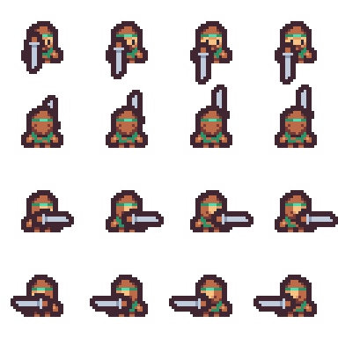
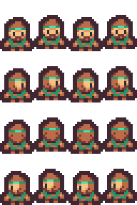
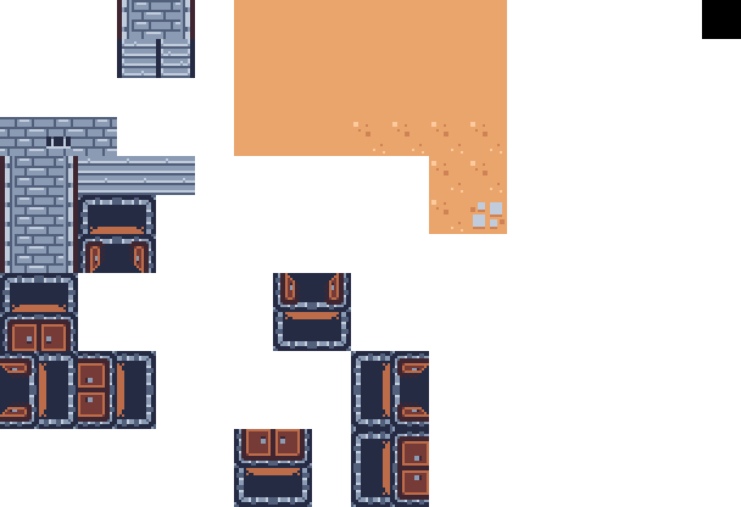
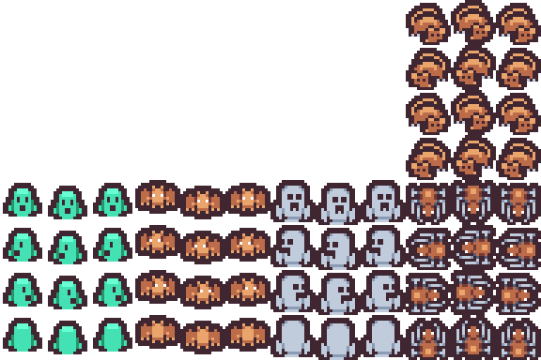
Assets
Notes:
The sheets: tiles, the player walking and swinging, and the monsters. Not all on the same grid size.

Slide 10
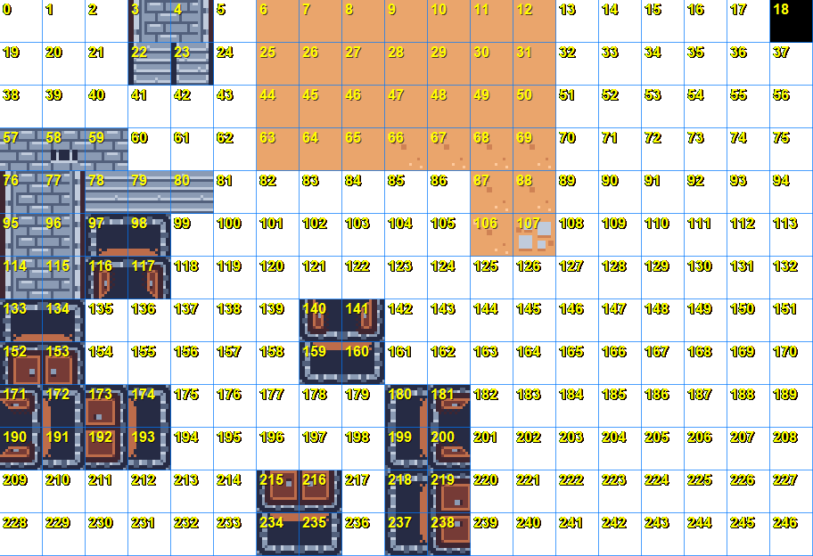
Tooling
Notes:
LabelTiles writes each tile’s number onto a copy of the sheet. The XML refers to tiles by number; nobody can read those off an image. Small tools like this are common in game projects.

Slide 11
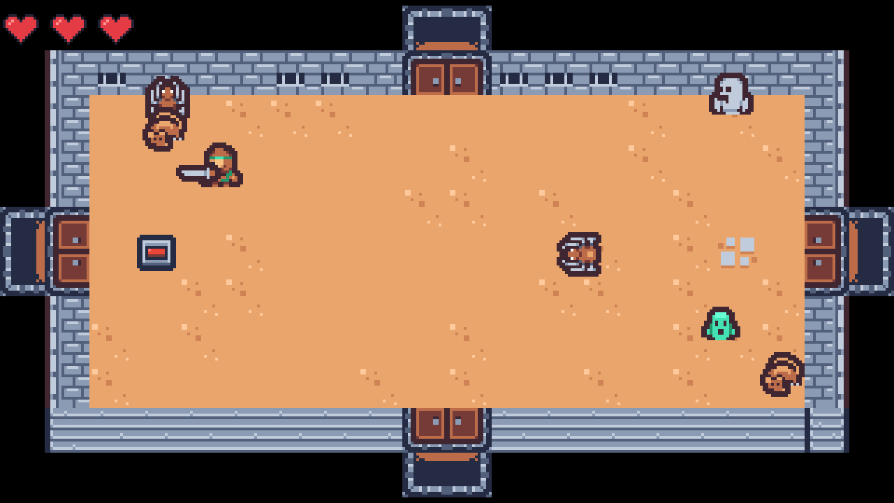
Top-Down Perspective
Notes:
The sprite is drawn higher than its collision box, so characters stand on the floor. Point at the player’s feet.

Slide 12
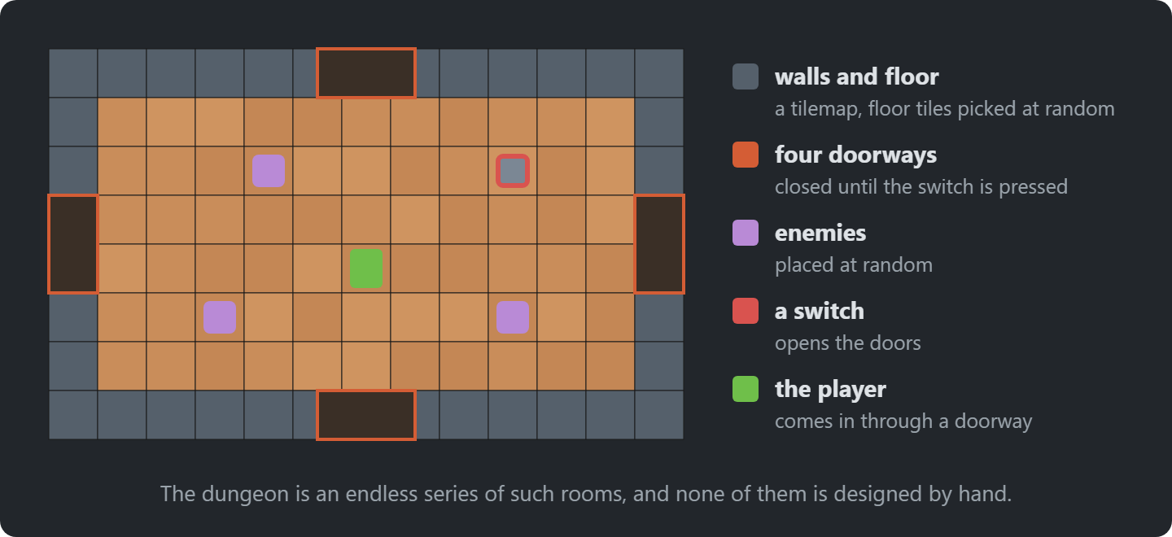
Dungeon Generation
Notes:
Each room is generated when entered: walls, a random floor, enemies, a switch and doors.

Slide 13
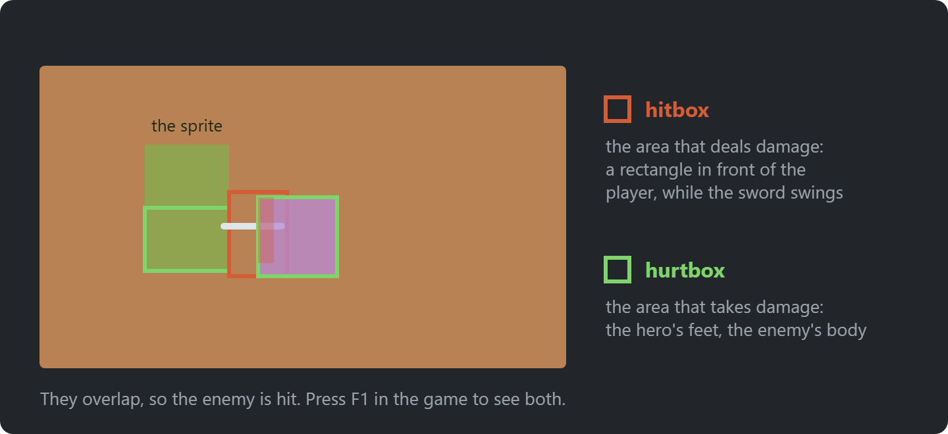
Hitboxes/Hurtboxes
Notes:
A hitbox deals damage (the sword), a hurtbox receives it (the body). Separate, so reach and body don’t have to match the sprite.
Show F1 debug drawing in the game.

Slide 14
Try It: Sword Reach
In Zelda7’s GameSettings:
Make the sword reach twice as far
Play: does it still feel fair?
Notes:
Pairs, about 5 minutes. SwordReach in GameSettings. The hitbox is built from it when a swing starts; the sprite doesn’t change, so hits now land where the sword isn’t drawn.

Slide 15
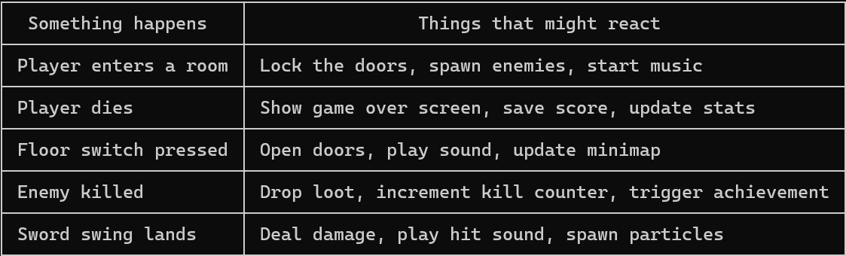
Events in Games
Games are full of moments where something happens and other things need to react
The thing that happened shouldn't need to know what those other things are
Events let you flip that around: the trigger just announces, anything that cares subscribes
Notes:
Something happens, and other things need to react. The thing that happened shouldn’t need to know them.
Ask: list moments in a game like this. Health changes, an enemy dies, a room clears, the sword swings.

Slide 16
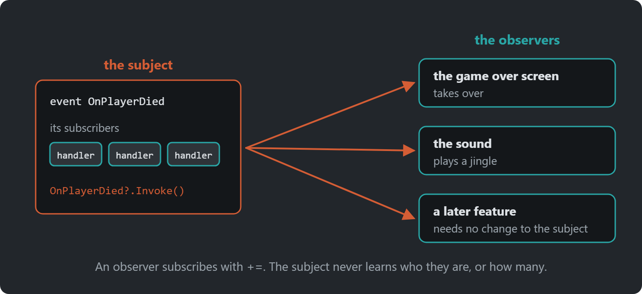
Observer Pattern
Notes:
The subject announces; observers subscribe. The dependency is flipped: the subject doesn’t know who listens.
Publisher and subscriber are other names for subject and observer.

Slide 17
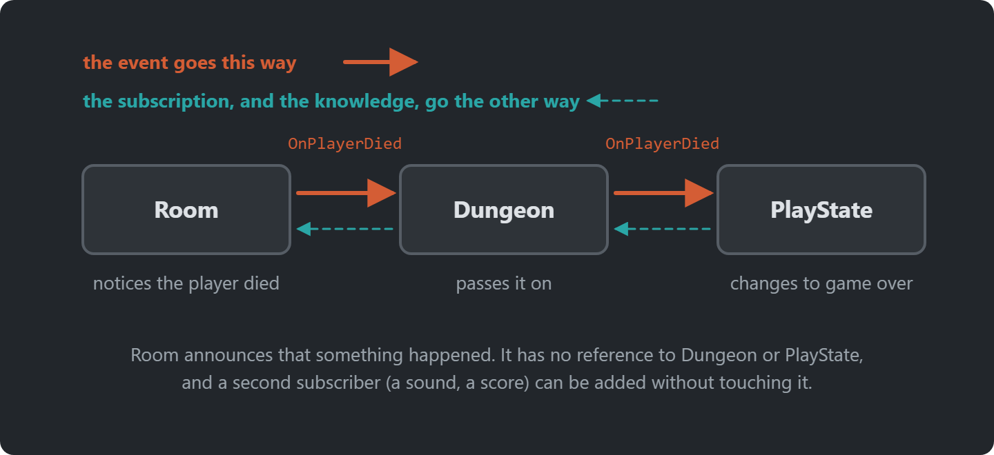
The Event Travels Up
Notes:
The room announces, the dungeon passes it on, the play state reacts. The subscriptions point the other way.
Ask: what does Room know about PlayState? Answer: nothing.

Slide 18
However…
In C#, we don’t need to implement the Observer pattern. Events are part of the language!
Notes:
In C# we don’t write the pattern ourselves: delegates and events are part of the language.

Slide 19
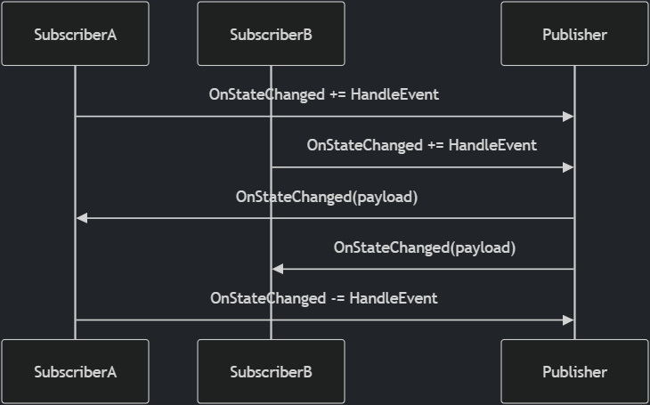
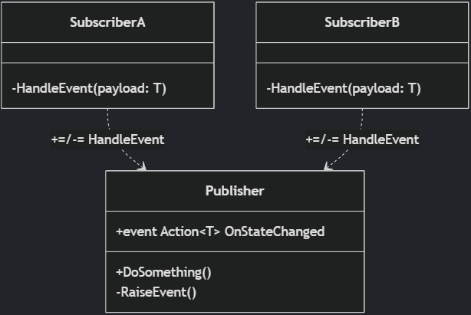
C# Events
Notes:
The same Observer structure, with C# events instead of an interface.

Slide 20
Delegates
A delegate is a variable that holds a reference to a method, to call later from anywhere.
// Built-in delegate types:
Action // returns void, no args
Action<T> // returns void, takes T
Func<T> // returns T, no args
// A delegate, as a property
public Action OnCollide { get; set; }
// The room adds a handler
switchObj.OnCollide += () => {
switchObj.State = "pressed";
foreach (var d in Doorways) d.IsOpen = true;
};
// Assign one handler
obj.OnCollide = () => Console.WriteLine("hit");
// Add multiple handlers
obj.OnCollide += () => PlaySound("hit");
obj.OnCollide += () => FlashRed();
// Call all subscribers
OnCollide?.Invoke();
Notes:
A delegate holds a reference to a method. Action and Func are the built-in ones. += adds a handler, Invoke calls them all.
Point at the switch in Room.cs: that’s where the room wires its door logic.

Slide 21
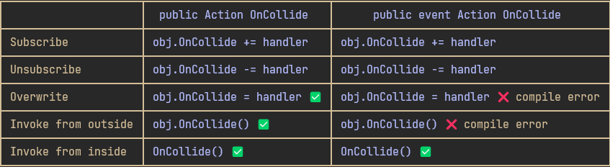
C# Events
An event is a delegate with guardrails
  It is still a delegate, but the event keyword restricts what outside code can do with it
Notes:
An event is a delegate with guardrails: outside code can only += and -=. The owner fires; everyone else listens.

Slide 22
Lambda Expressions
(parameters) => expression
A lambda is an anonymous function
  A function defined inline, without a name
The value of the expression is returned
Used to pass behaviour as an argument, and to subscribe to events
bool IsEven(int n) { return n % 2 == 0; }
// The same thing as a lambda
(int n) => n % 2 == 0
Notes:
A lambda: a function without a name, written where it’s used. The same IsEven, twice.

Slide 23
Lambda Expressions & Events
switchObj.OnCollide += () =>
{
if (switchObj.State == "unpressed")
{
switchObj.State = "pressed";
foreach (var d in Doorways)
d.IsOpen = true;
}
};
The lambda captures variables from its surrounding scope
  E.g. switchObj & Doorways. This is called a closure.
Without lambdas, the switch behaviour would need to be a separate named method that somehow still had access to switchObj and Doorways
Notes:
The switch handler captures switchObj and Doorways from the room: a closure.
Ask: what would this look like as a named method? It would need both as fields or parameters.

Slide 24
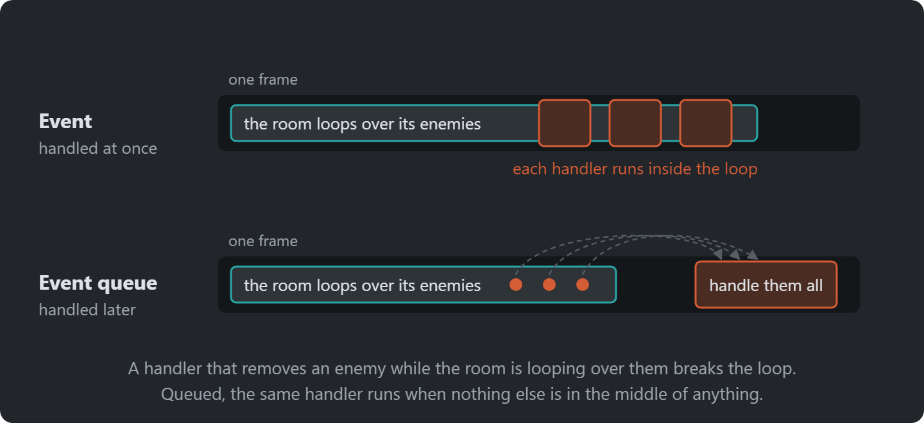
Event Queue
Notes:
An event is handled inside the call that raises it. A queue stores it and handles it later, at a safe point.
Ask: where have we queued before? Answer: Snake's turns, one per tick.

Slide 25
Try It: A Second Listener
In Zelda7, in PlayState:
Add a second subscriber to _dungeon.OnPlayerDied that plays a sound
Which classes did you change? Which didn’t need to know?
Notes:
Pairs, about 5 minutes. One line in PlayState: _dungeon.OnPlayerDied += () => SoundManager.PlaySound("hit-player");
Room and Dungeon don’t change, and don’t know about the sound: that’s what the event is for.

Slide 26
Making Zelda (more) Event-driven
Pick one and make it event-driven. The class firing the event must not know who reacts.
OnPlayerDied: trace the chain from the room to the game-over screen
Enemy death: what could react to an event for it?
SoundManager.PlaySound is called from many classes. How would events help? Then queue the sounds, and play each once per frame
Notes:
Exercise: pick one of the three and refactor it. The class firing the event must not know who reacts.
The OnPlayerDied chain is the one to trace first: room, dungeon, play state.
The sound queue: a HashSet of names that PlaySound adds to (duplicates merge for free), played and cleared once per frame after the update. A sound can be up to a frame late; nobody hears it.
Full instructions are on the course site; students work from there. Walk round while they work.

Slide 27
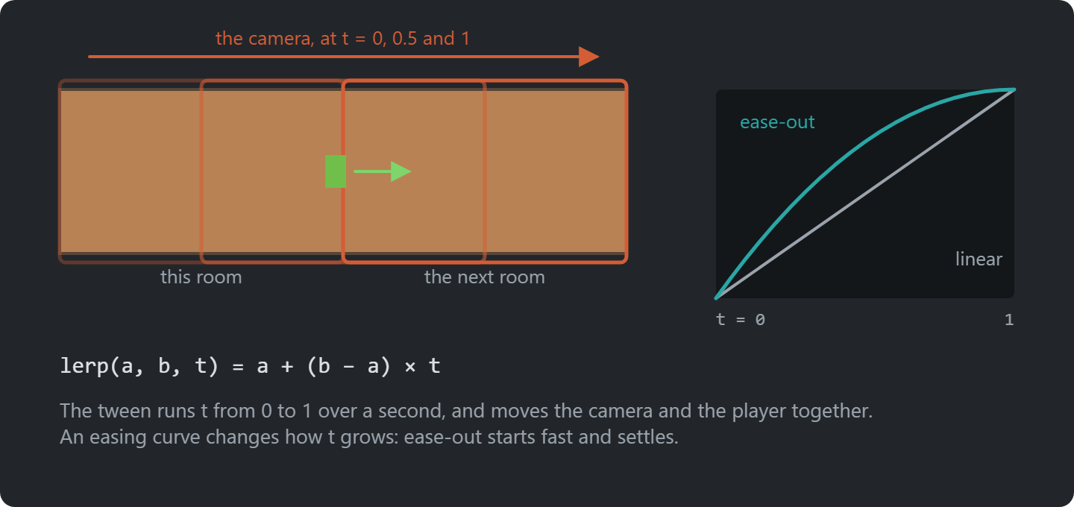
Screen Scrolling
Notes:
The original’s scroll between rooms. How would you build this?

Slide 28
Tweening
Tweening moves a value from A to B over time.
linear
ease-out
The same nine frames. Where the dots bunch up, the value moves slowly.
More curves: easings.net
Notes:
A tween moves a value from A to B over time. The dots are nine frames of the same move: evenly spaced for linear, bunched up at the end for ease-out.

Slide 29
Linear Interpolation
Linear interpolation: the simplest curve.
lerp(a, b, t) = a + (b - a) * t // t from 0 to 1
t = 0
a
t = 0.5
halfway
t = 1
b
Works on anything numeric: positions, colours, angles.
Notes:
lerp: a plus a fraction of the way to b. t = 0, a; t = 1, b. Works on positions, colours, angles.

Slide 30
Screen Scrolling
The next room waits one screen away. The camera moves, and the player walks with it.
This room
The next room
placed one screen away,
never moves
camera
_tweens.Tween(GameSettings.RoomShiftDuration)
.Add(t => /* move the camera */, 0f, 1f).Add(t => /* walk the player */, 0f, 1f)
.Finish(FinishShift); // the next room becomes the current one
Notes:
The next room is placed one screen away and never moves. The camera tweens towards it while the player walks through the door.
When the tween finishes, the next room becomes the current one.

Slide 31
A Tweening System
Games tween all the time: fades, flashes, menus, floating numbers
GARCore gets a reusable TweenManager
  Tween: values from A to B over time
  After: run a method later
  Every: repeat at an interval
  Chaining: .Add() and .Finish()
The dungeon keeps no progress variable, and never asks if the scroll is done
_tweens.Tween(duration)
.Add(t => _camera.Position =
Vector2.Lerp(from, to, t), 0f, 1f)
.Finish(FinishShift);
_tweens.After(0.5f, () => Flash());
_tweens.Every(0.1f, Blink).Limit(6);
// Every frame
_tweens.Update(gameTime);
Notes:
Games tween constantly, so GARCore gets a TweenManager: Tween, After, Every, chained with Add and Finish. No progress variables anywhere.

Slide 32
Try It: A Slower, Softer Scroll
In Zelda7:
Make the room shift take twice as long
Ease out: pass 1 - (1 - t) * (1 - t) to Vector2.Lerp instead of t
How does the scroll feel now?
Notes:
Pairs, about 5 minutes. RoomShiftDuration in GameSettings. The ease-out goes in the two Add setters in Dungeon.BeginShift. It starts fast and settles: most game UI eases out.

Slide 33
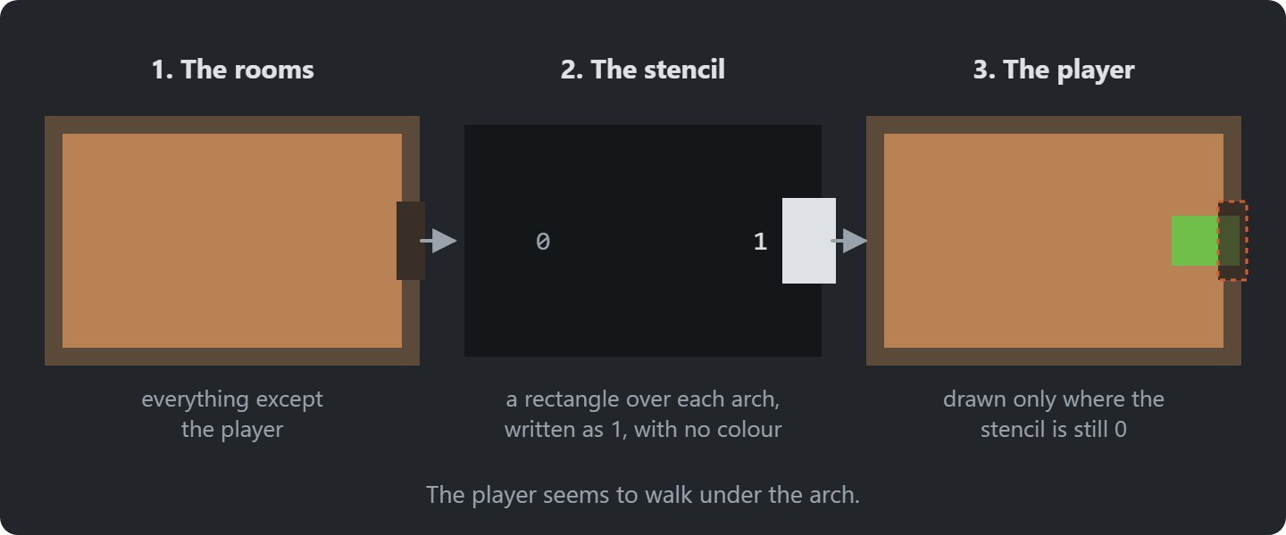
Stenciling
Walking through a door, the player should go under the arch.
Notes:
Without it, the player is drawn over the door arch. Three passes: rooms; arch masks into the stencil buffer only; the player where nothing is marked.
Pass 1: draw the rooms
Pass 2: mark the arches
in the stencil buffer, with no colour
Pass 3: draw the player again
only where nothing is marked

Slide 34
Data Driven Design
Content in data, behaviour in C#: a new enemy is one XML block and a row of sprites.
<Enemy type="rat" width="16" height="16" walkSpeed="20" health="1">
<Animation name="walk-down" frames="9,10,11,10" interval="0.2" />
<Animation name="idle-down" frames="10" interval="0.2" />
</Enemy>
The definition classes read the XML once; the rest of the code never sees it.
GameObject has no if (type == "switch") anywhere.
Someone writes type="rta". When do you find out?
Notes:
A new enemy is one XML block and a row in the sheet. Ask the question: someone writes type="rta". When do you find out? Only at runtime. That’s the cost.

Slide 35
Composition vs. Inheritance
An enemy that flies, one that shoots, one that does both. Where do they go?
Entity
Enemy
FlyingEnemy
ShootingEnemy
ExplodingEnemy
FlyingShootingEnemy? copy code, or move it all up?
“Favor object composition over class inheritance.” Gang of Four
Notes:
Build the tree with them: Enemy, then flying, shooting and exploding enemies. Then ask: an enemy that flies and shoots?
Copy the code, or move it up into Enemy until every enemy carries everything. Neither is good.

Slide 36
Composition in Zelda
Zelda already composes. Ask whether it’s what something is, or what it can do.
Behaviour in state objects
an enemy’s AI is the state
it holds
Behaviour wired from outside
a switch is a plain GameObject;
the room attaches OnCollide
Enemy types as data
they come from XML,
with no class for each
Plants vs. Zombies takes this all the way, with the Component pattern.
Notes:
Zelda already composes in three ways; go through the boxes.
The question to keep asking: is this what something is, or what it can do? Plants vs. Zombies takes it all the way.

Slide 37
Keys and Locked Doors
Start from Zelda7. Full instructions are on the course site.
Some enemies drop a key when they die: use an event
A locked state for doorways, in door_layouts.xml
A key opens a locked door for good; show the keys next to the hearts
Notes:
Exercise: keys dropped by enemies, and locked doors they open.
It joins the two ideas of the day: the key drop is an event, the locked look is data.
Full instructions are on the course site; students work from there. Walk round while they work.

Slide 38
Exercise: Composition
Sketch the class hierarchy for enemies that can walk, fly, shoot or explode, in any combination
Then sketch it with composition: which parts would an enemy have?
Implement one part
  E.g. a shooting behaviour that any enemy can be given
Notes:
Exercise: sketch the hierarchy, then the composition, then implement one part (a shooting behaviour any enemy can have).

Slide 39
Check Yourself
When does inheritance fit, and when is composition better?
Why does Observer suit UI code particularly well?
What is the difference between a delegate and an event in C#?
What is the cost of data-driven design?
The answers, and more questions, are on the course site.
Notes:
Ask one question at a time. Pairs discuss for a minute, then take two or three answers.
Expected answers (from the course site):
Q: When does inheritance fit, and when is composition better?
A: Inheritance fits when there is one clear "is a" axis and the shared behaviour is needed by every subclass. Composition fits when behaviours combine freely. Instead of one subclass per combination, an object has the parts it needs, and they can even change at runtime.
Q: Why does Observer suit UI code particularly well?
A: The UI depends on the game data, but the game shouldn't depend on the UI. With events, a health bar subscribes to an event on the player, and gameplay code never needs to know a health bar exists. The UI also only updates when something actually changes.
Q: What is the difference between a delegate and an event in C#?
A: An event is a delegate that outside code can only subscribe to and unsubscribe from. Only the declaring class can invoke it or overwrite its subscriber list.
Q: What is the cost of data-driven design?
A: Errors move from compile time to runtime, you need loading and validation code, and behaviour is split between code and data files.

Slide 40
Apply It to Your Project
What are the meaningful moments in your game?
  The things that happen that other systems might care about
Map out at least two of them
  What fires the event, and what should react?
Is there anywhere a class knows too much about another?
  Could an event fix that?
Where does your game use inheritance?
  Is each subclass what something is, or what it can do?
Notes:
Give the project groups five minutes with these questions.
Ask two groups to share one answer each, and push them to name actual classes and files.

